Slide 1
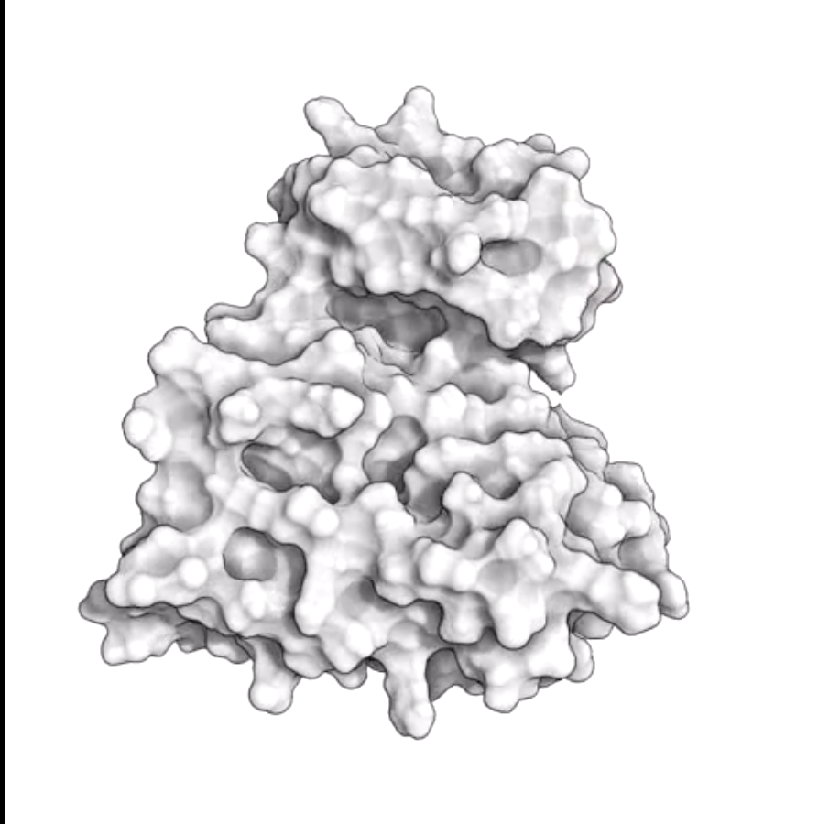
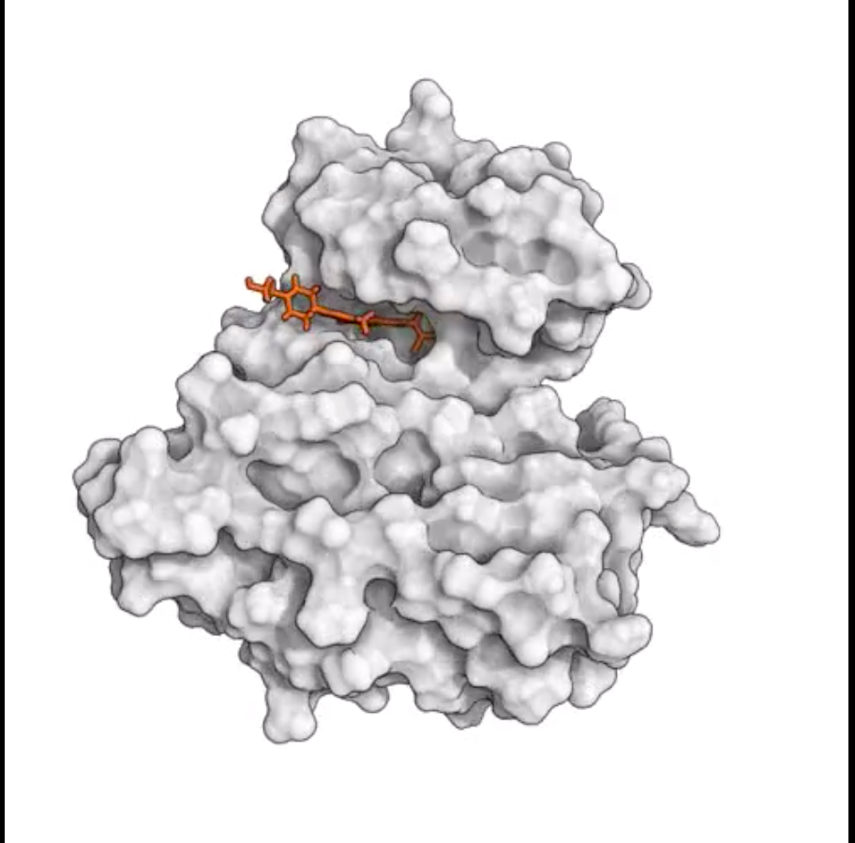
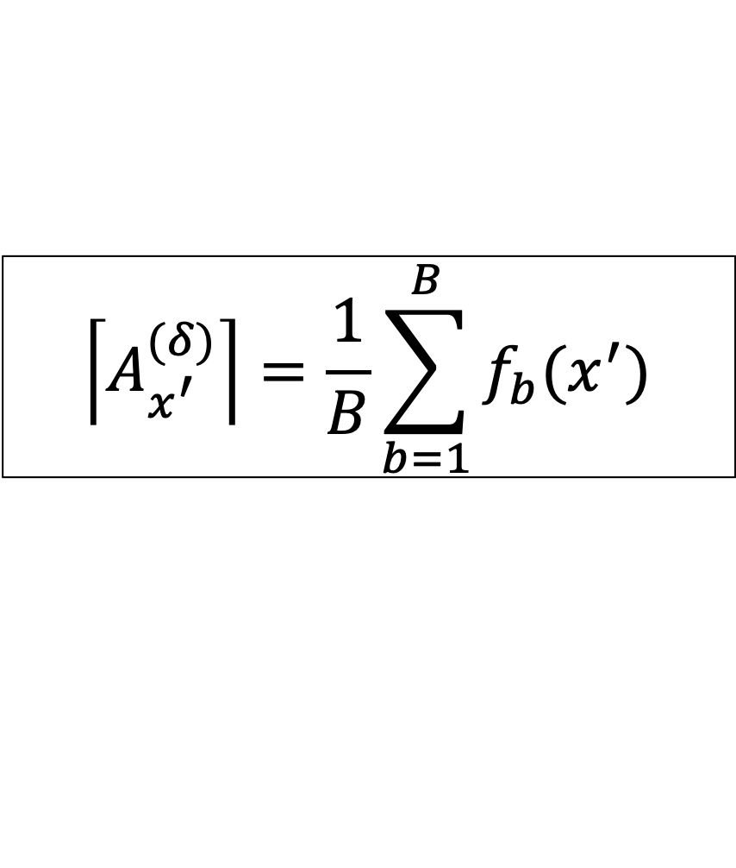
Inferring GPCR binding site structure with Random Forests
Jacob Levitt^{1,2}, Jessica Freeze², Victor Batista²
GPCR largest druggable family, lack 3D structures (475 FDA-approved drugs vs. 270 PDB structures with bound ligand)^{A}
$$\left\lceil A_{x^{′}}^{(δ)}\right\rceil =\frac{1}{B}\sum_{b=1}^{B}{f_{b}(x^{′})}$$
^{B}
Random Forest Univariate Regression
data source: GLASS database (~500 examples)
features: one-hot GPCR primary sequences
output: ceiling surface area
Error: ~26 Å² (ethanol ~ 28 Å², water ~ 10 Å²)
bound cavity surface area (≠ unbound) ‘encoded’ by ligand
^{A} Jabeen, A., & Ranganathan, S. (2019). Applications of machine learning in GPCR bioactive ligand discovery. Current opinion in structural biology, 55, 66-76.
^{B} Shan, Y., Kim, E. T., Eastwood, M. P., Dror, R. O., Seeliger, M. A., & Shaw, D. E. (2011). How does a drug molecule find its target binding site?. Journal of the American Chemical Society, 133(24), 9181-9183.
¹ Yale University Department of Molecular Biophysics and Biochemistry
² Yale University Department of Chemistry

